Slide 1
Micro Credit Defaulter Project
Submitted by-
Neha Chand

Slide 2
Micro Credit Project Problem Statement
A Microfinance Institution (MFI) is an organization that offers financial services to low income populations. The Microfinance services (MFS) provided by MFI are Group Loans, Agricultural Loans, Individual Business Loans and so on.
Telecom Industry are collaborating with an MFI to provide micro-credit on mobile balances to be paid back in 5 days. The Consumer is believed to be defaulter if he deviates from the path of paying back the loaned amount within the time duration of 5 days. For the loan amount of 5 (in Indonesian Rupiah), payback amount should be 6 (in Indonesian Rupiah), while, for the loan amount of 10 (in Indonesian Rupiah), the payback amount should be 12 (in Indonesian Rupiah).

Slide 3
Solution
In order to improve the selection of customers for the credit, the client wants some predictions that could help them in further investment and improvement in selection of customers.
Build a model which can be used to predict in terms of a probability for each loan transaction, whether the customer will be paying back the loaned amount within 5 days of insurance of loan. In this case, Label ‘1’ indicates that the loan has been payed i.e. Non- defaulter, while, Label ‘0’ indicates that the loan has not been payed i.e. defaulter.

Slide 4
EXPLORATORY DATA ANALYSIS
Exploratory Data Analysis(EDA) is an approach of analyzing data sets to summarize their main characteristics, often using statistical graphics and other data visualization methods.
Here we check our data and understand what kind of data is present to us, it is supervised or unsupervised and then check the output/ target column is continuous or categorical.
Then visualize our data with the help of different plots with the help of python libraries such as Matplotlib as Seaborn.

Slide 5
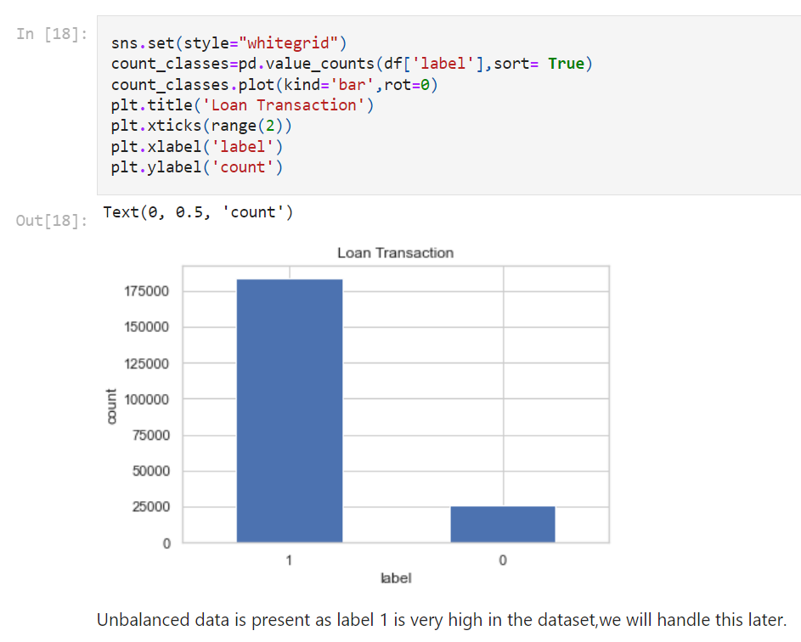
EDA contd..
The plots we used are:
Countplot : To visualize our target column and check the distribution of data.

Slide 6
VISUALIZATION
2. Histogram : A histogram is representation of the distribution of numerical data, where the data are binned and the count for each bin is represented. Here histogram is used to check the distribution of data among the different numerical features.
3. Stripplot : A strip is basically a scatter plot where the x-axis represents a categorical variable. Here we used to check the features with respect to target column.
4. Scatterplot : A scatter plot is a diagram where each value in the data set is represented by a dot. The Matplotlib module has a method for drawing scatter plots. Scatterplot is used to check the distribution of data between two columns.
5. Heatmap : A Heatmap is used to check the correlation among the features and also with target column.

Slide 7
Data Cleansing
Step 1: Dropping unnecessary variables
remove those which are not actually related to our prediction like One type of Telecom Industry name.
Step 2: Removing the features which are highly correlate
Now remove those columns which are highly correlated to each other.

Slide 8
Feature Selection
Defining the Target and Predictor Variable i.e. divide the data into x and y where x contain the predictor variable and y contain the target variable.
Feature ranking with recursive feature elimination.
Using RFE for selecting the top 25 columns which are very useful for the further process and are important to the target column i.e. related to the target column in some way.
Selecting the best ranked features.

Slide 9
Contd..
REMOVING OUTLIERS
By the method zscore from scipy , we remove the outliers so that model can predict correct.
Handling the Class imbalance data
Using the Undersampling method from imblearn library so that we balance the Target dataset .
Undersampling refers to a group of techniques designed to balance the class distribution for a classification dataset that has a skewed class distribution. It is best understood in the context of a binary (two-class) classification problem where class 1 is the majority class and class 0 is the minority class , in our case 1 is very high and 0 are very few.

Slide 10
MODEL SELECTION
Step 1: Splitting the dataset into Training and Testing for the model prediction.
Step 2: Using Machine learning Algorithm:
1. Logistic Regression
2. Linear SVC
3. Gaussian Naïve Bayes
4. Decision Tree Classifier
5. Random Forest Classifier

Slide 11
Model Evaluation Metrics
Classification Metrics
Classification Accuracy
Confusion Matrix
Classification Report
Area under curve(AUC)
Cross-validation is a technique that is used for the assessment of how the results of statistical analysis generalize to an independent data set. Cross-validation is largely used in settings where the target is prediction, and it is necessary to estimate the accuracy of the performance of a predictive model.

Slide 12
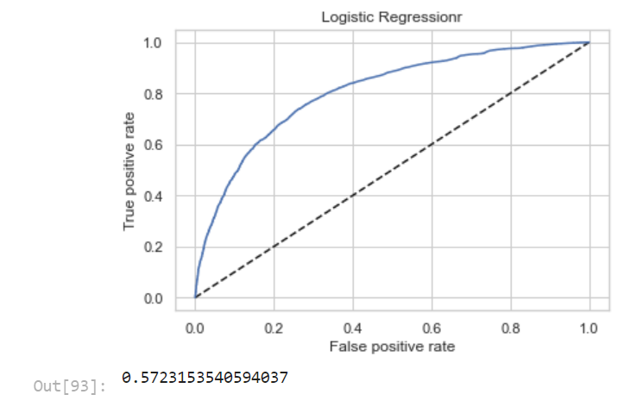
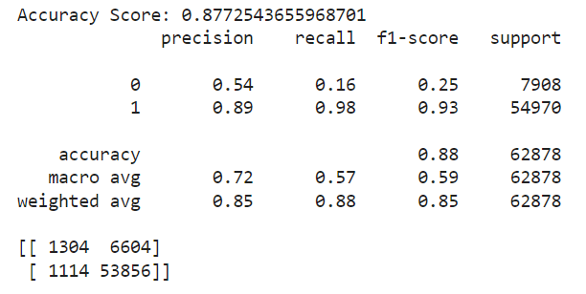
Contd..
Calculate Evaluation Metrics for different Model :
Here is the result:
1. Logistic Regression:
Cross validation score : 0.87

Slide 13
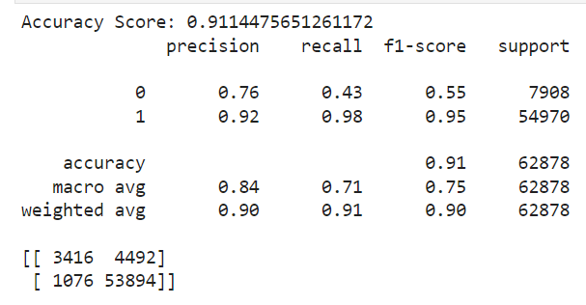
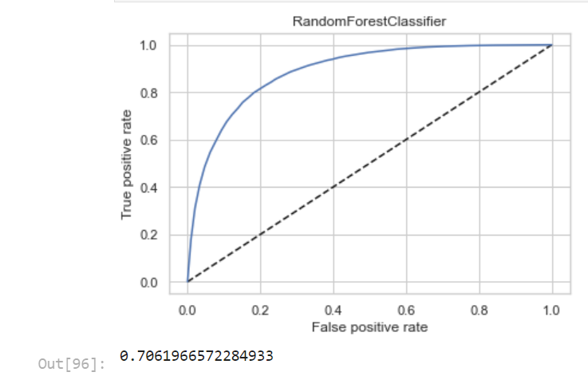
Conttd..
2. RANDOM FOREST CLASSIFIER:

Slide 14
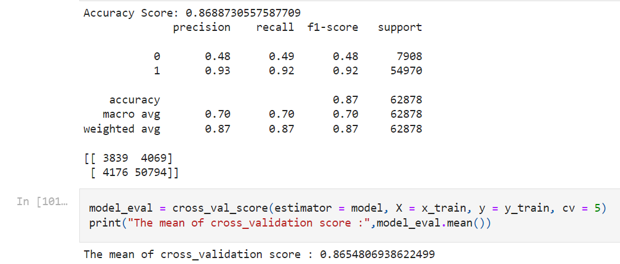
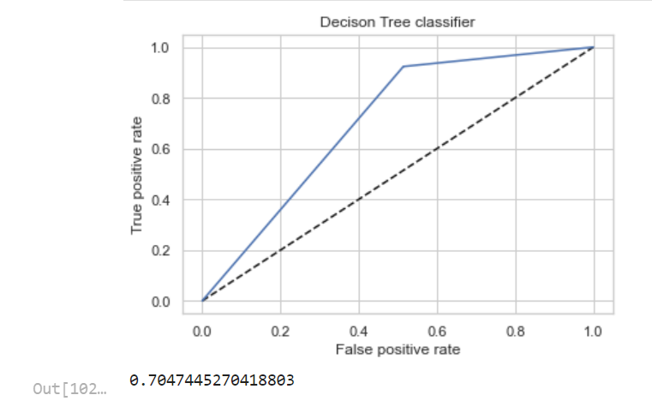
Contt..
3. Decision Tree Classifier:

Slide 15
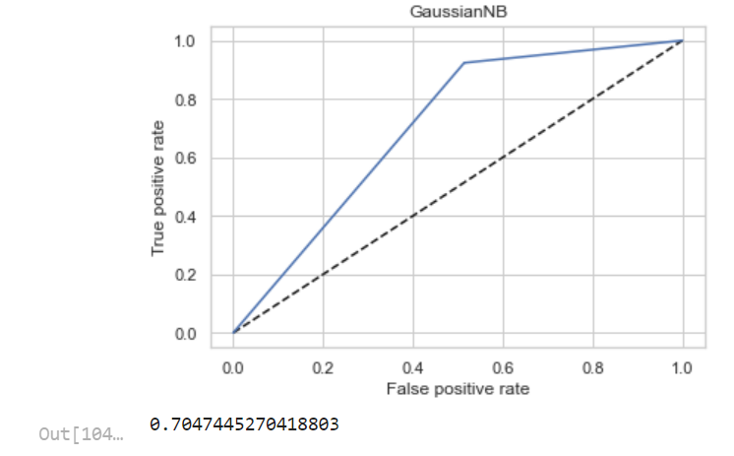
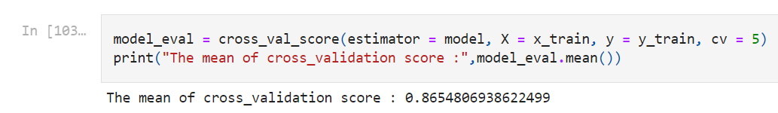
Conttd..
4. Gaussian NaïveBayes

Slide 16
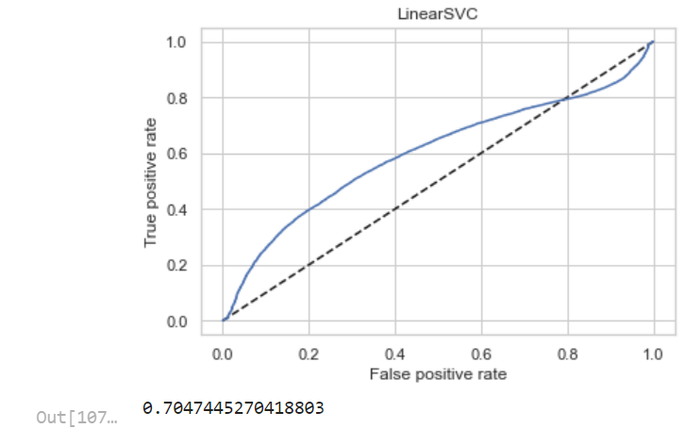
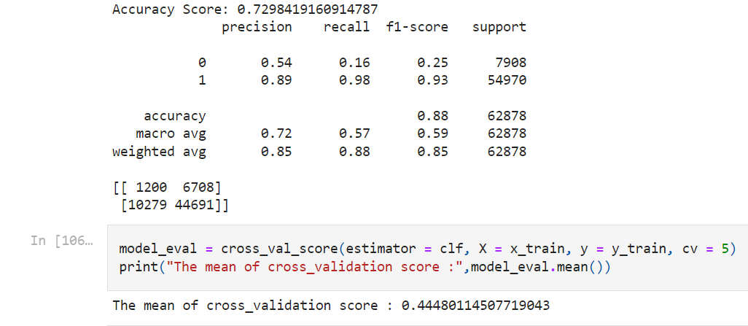
Contd..
5. Linear SVC:

Slide 17
Observation:
From all the model prediction we can see that the aucroc score of Decision Tree classifier is highest among all. Hence, we can use this model for the hyperparameter tuning and the prediction for our best model result.

Slide 18
Hyperparameter tuning
In machine learning, hyperparameter optimization or tuning is the problem of choosing a set of optimal hyperparameters for a learning algorithm. A hyperparameter is a parameter whose value is used to control the learning process. By contrast, the values of other parameters (typically node weights) are learned.
The parameter after Hyperparameter tuning of decision Tree Classifier:

Slide 19
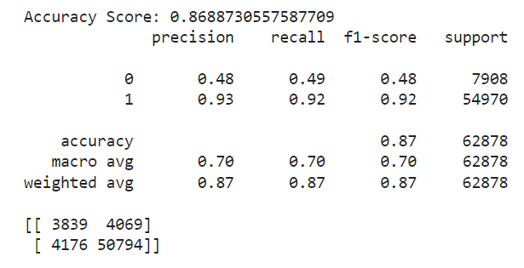
Final
Final modelling and evaluating using Best Parameteres
From above we can see the accuracy score of DecisionTree Classifier after hyperparameter tuning.

Slide 20
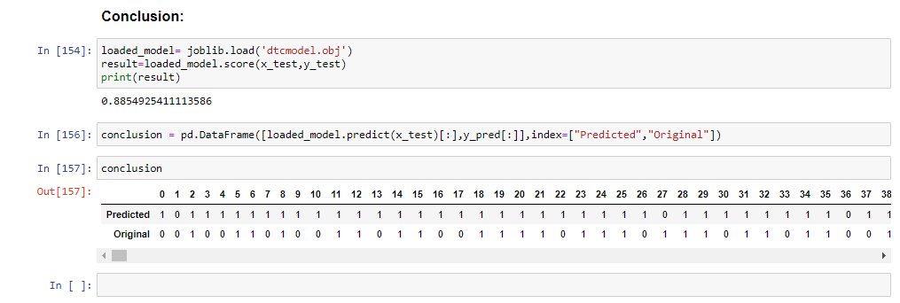
Conclusion:
The final model DTC has an Accuracy of 0.89 and AUC_ROC score of 0.70.

Slide 21
THANKYOU.

